Slide 1
Mortality rates in 2020 Using tiMe-series models to put state numbers in context
Luken Weaver, General Assembly, DSI Immersive, 6/9/2020

Slide 2

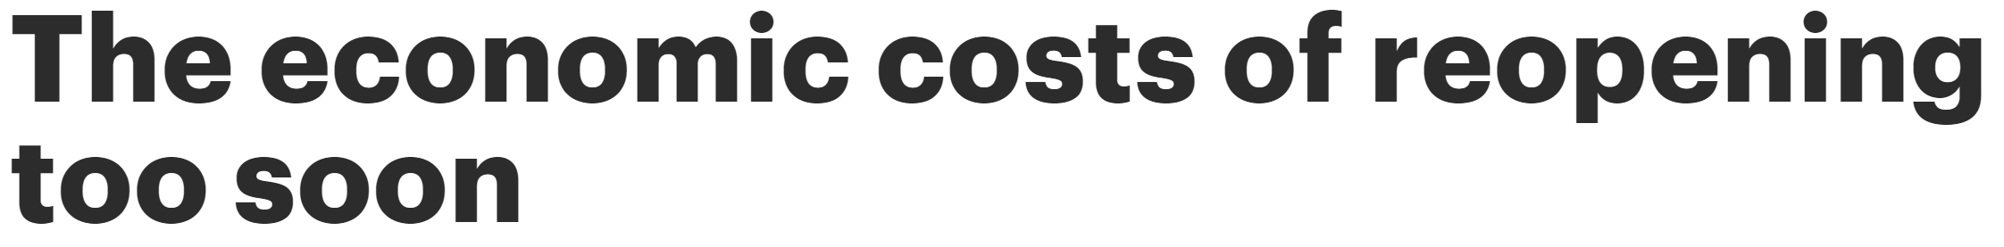


The big picture
The 2020 covid-19 outbreak has killed over 100,000 Americans, by official estimates.
The ensuing lockdown has led to the loss of over 36.5 million jobs.
Both of these presumably have large-scale ripple effects, making an accounting of the full consequences, their analysis, and the relative risk assessment of different policy approaches difficult.

Slide 3

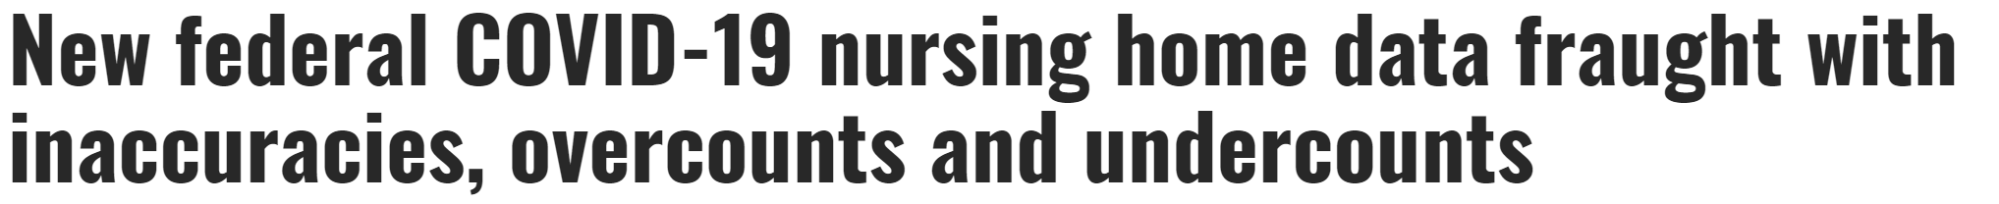

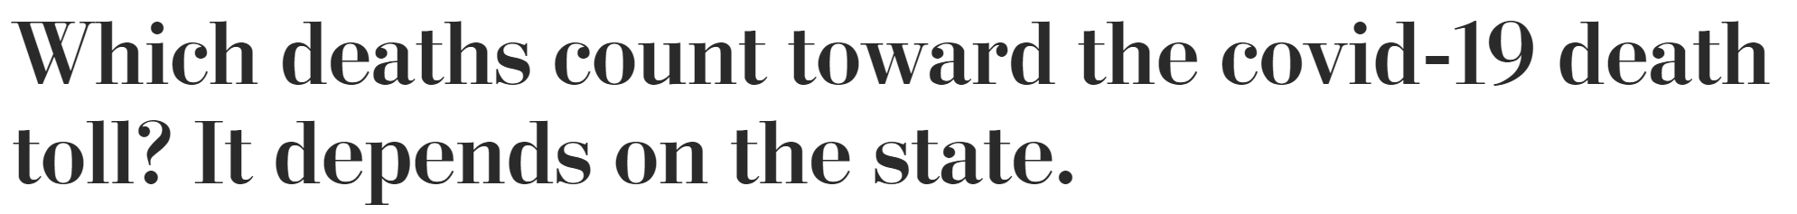
The granular level
Inconsistencies with how key metrics are tracked and reported, and the potential for blind spots toward other markers, further muddy the waters of what can be considered an accurate assessment of the situation.

Slide 4
The questions
When controlling for past years in a given area, do we see a noticeable change in overall mortality rate in 2020, compared to what a ‘typical’ year would be?
Can this change be reliably predicted from other features about the area? Are static features more or less predictive than policy response?

Slide 5
The proposal
Use historical data to construct a time-series model that will predict death rates for 2020 for each state*
If 2020 is in fact an aberrant year in terms of mortality, these forecasts will be inaccurate by design
The degree by which the observed numbers differ from the model can be a parameter of interest in itself, representing the degree to which a state has been knocked ‘off course’ by the crisis
Can this metric be predicted? Feed possible explanatory features into a supervised learning model and look for patterns.
* Comparing either smaller-scale (cities) or larger-scale (countries) areas would likely be a better fit for the second part of this project. Due to the constraints of available data, states were chosen as the unit of analysis as proof of concept.

Slide 6
The data
The Economist’s James Tozer and Martín González author and maintain a Covid-19 Excess Deaths tracker github. The historical weekly death rates they collated from the CDC will be the basis of part one of this analysis.
For part two, select data was gathered about each state from the Department of Labor, Census Bureau, and independent websites listed in the citations section at the end of this presentation.

Slide 7
Part One Time Series

Slide 8
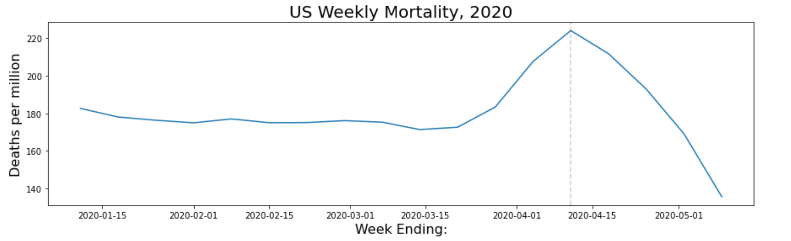
Data problems
Death rates spike in the week ending April 11th. A come-down afterward is expected. However, we are seeing death rates drop significantly below averages for the year.

Slide 9
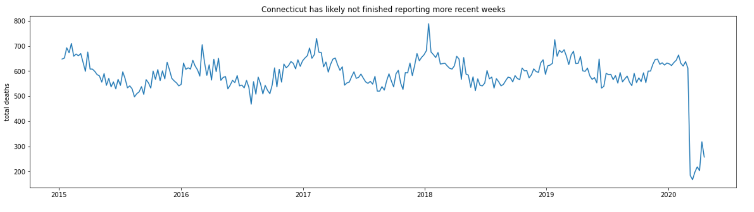
Not just missing values
Connecticut weekly death rate
Connecticut leaps out as the most severe example. In addition to some missing values that had not yet been reported as of the data pull, the numbers that had been reported are significantly lower than average at precisely the time that one would expect them to be very high, from reports of covid-19’s spread.

Slide 10
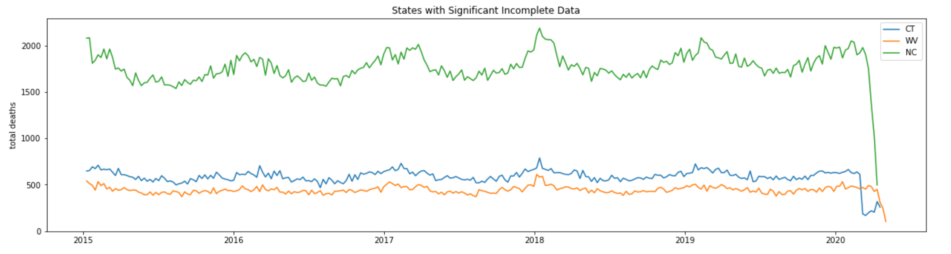
Not just Connecticut
And while not overly wide-spread, CT was not the only state that presented this kind of non-credible data set. States are highly inconsistent with their reporting, making more recent data shakier in its reliability than it might seem.

Slide 11
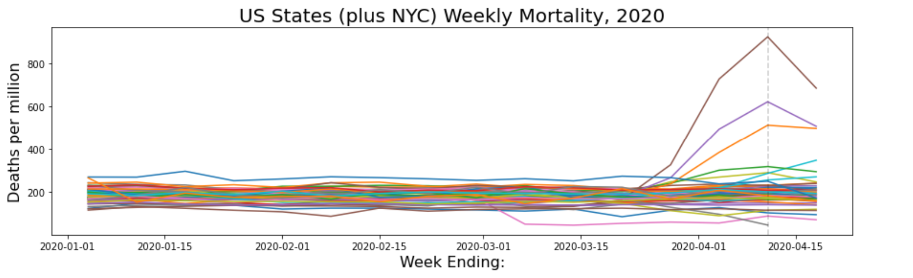
Cutting down the test data
Ultimately, the decision was made to cut off the last three weeks of our dataset as unreliable in general, leaving the above as our 2020 data that our model’s forecast will be compared to.

Slide 12
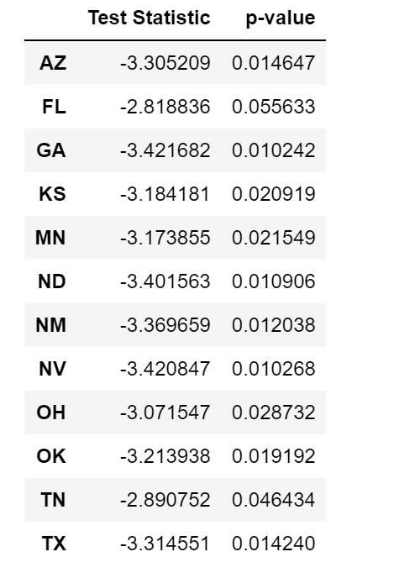
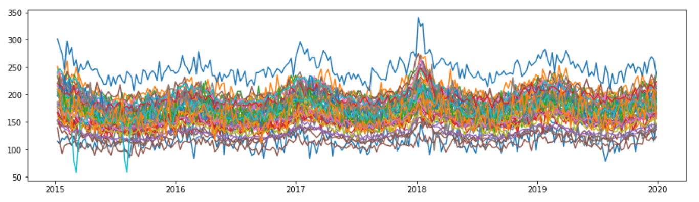
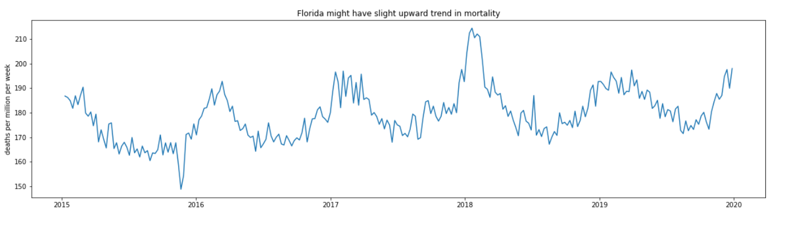
How do we handle training data?
Dickey-Fuller edge cases
All States
Most states, and the country overall, seem stationary, but some would fail a Dickey-Fuller test at sigma = 0.1
FL
Florida fails even a more relaxed sigma = 0.5

Slide 13
What do we train our model on?
Using one model to forecast all states would miss any dynamics happening at the individual state-level, defeating the purpose of comparison. Each state needs its own model.
However, there would be concerns over consistency if comparing the results of two differently designed models.
Additionally, grid-searching to find the best parameters for each state would be computationally intensive.
The decision was made to find tune a model to best predict trends at a national level, then use those parameters to fit on each state’s training data (i.e. death rate prior to 2020).

Slide 14
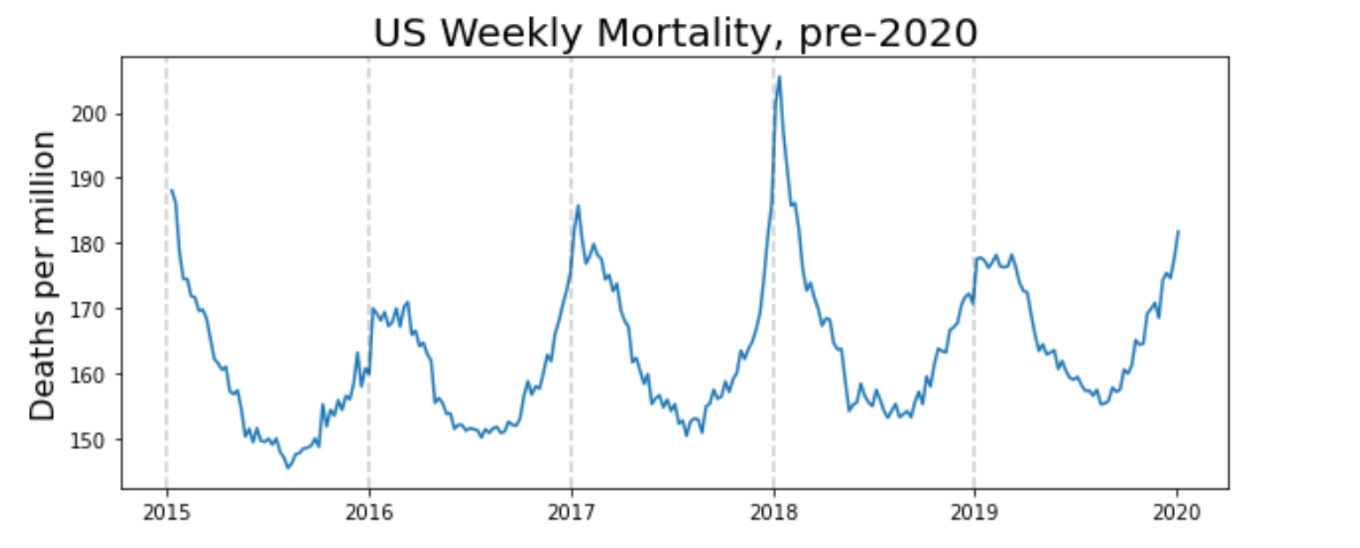
Our training data. Commence grid-search…

Slide 15
50+ hours later…

Slide 16
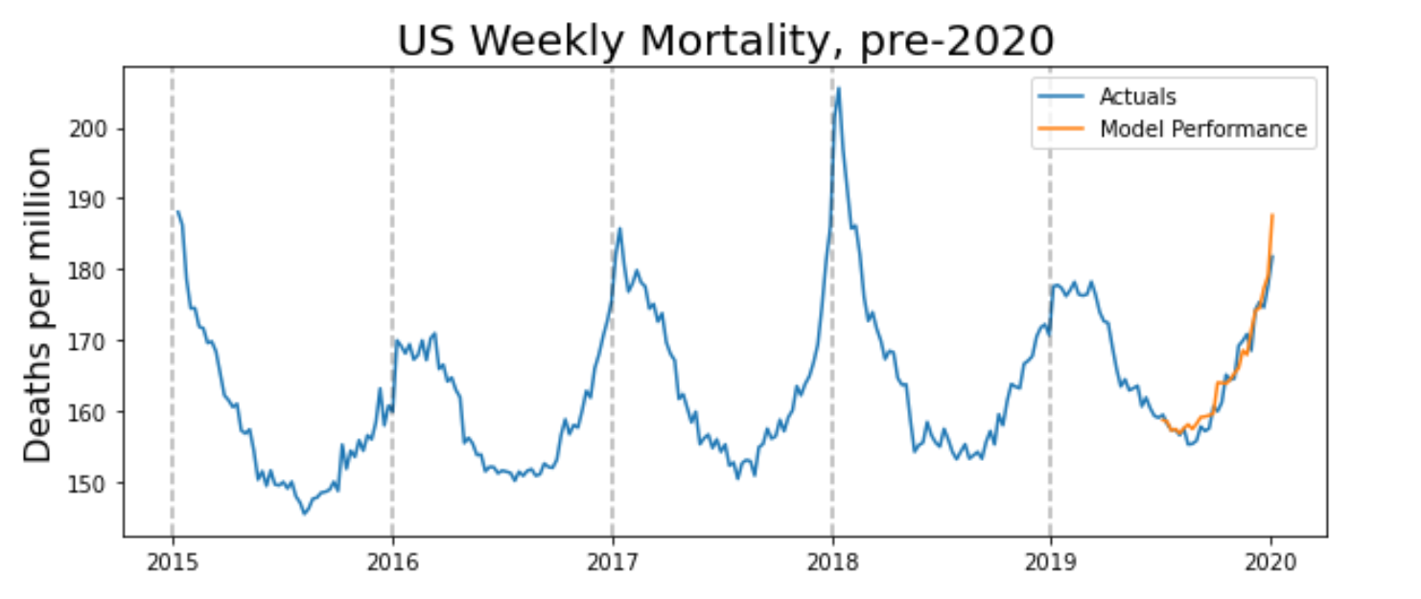
50+ hours later…

Slide 17
50+ hours later…
An Arima model order (3, 1, 1) with a seasonal component of order (3, 1, 0) received our best AIC score*
* some models did in fact score slightly better, but as they received convergence warnings and had features scored with concerningly high p-values for significance, they were discarded

Slide 18
Converting forecasts into a parameter of interest
A model with the parameters above was fit to each state’s weekly death rate data for the year, and this model was then used to forecast the data for 2020 as far as the data that we do have was deemed reliable enough.
The mean of each state’s residuals was then calculated, deriving the target metric for each state, termed Death Rate Change (or DRC).

Slide 19
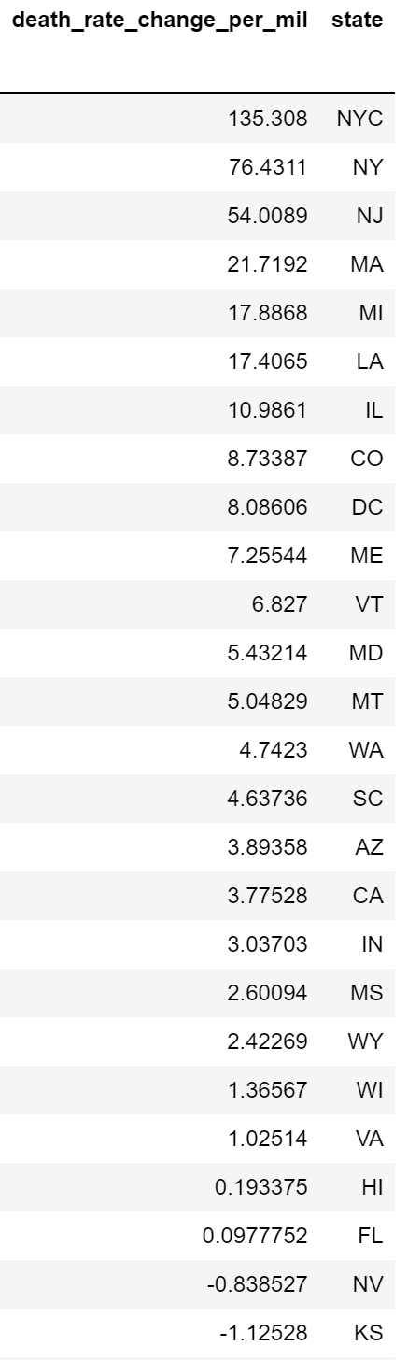
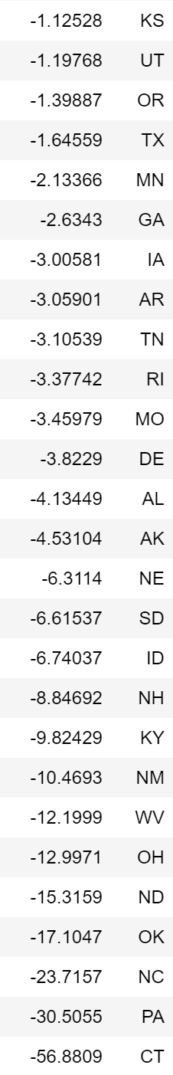
Results
Taking out the two cities (NYC and DC), exactly half of US states experienced fewer reported fatalities from all causes so far in 2020 than our model forecast.

Slide 20
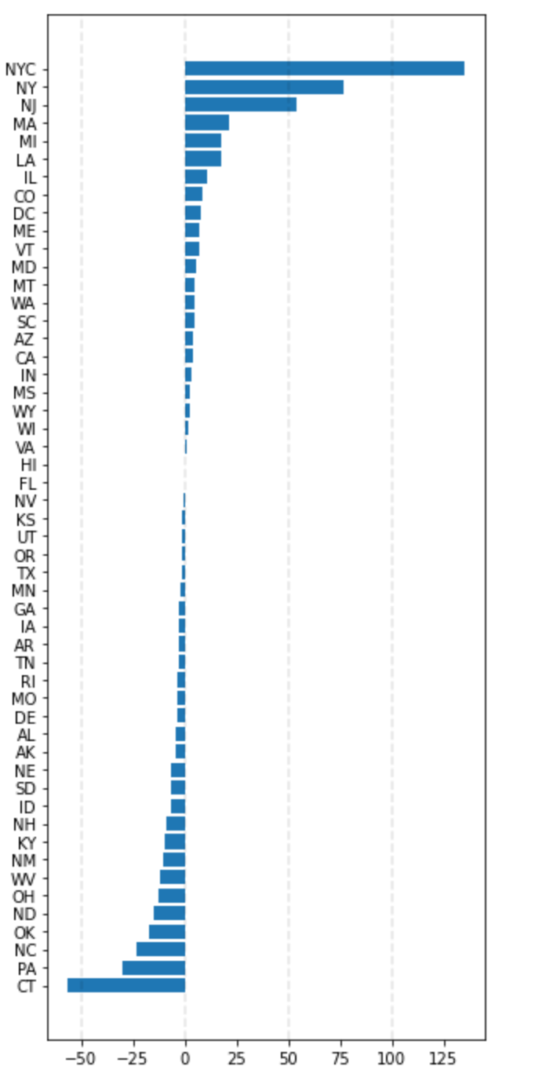
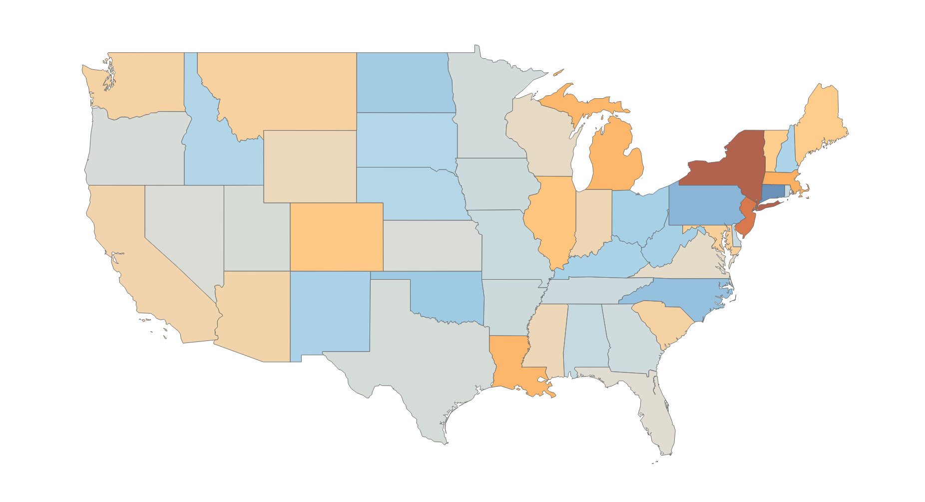
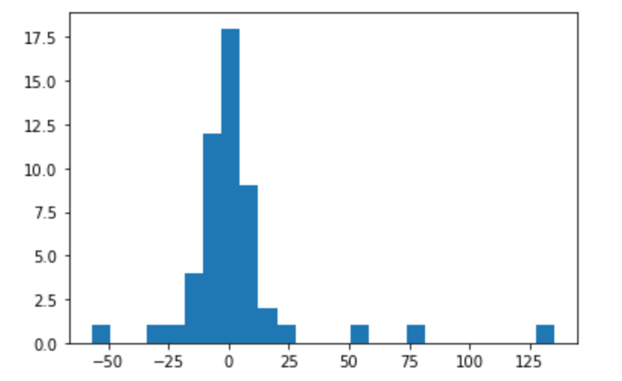
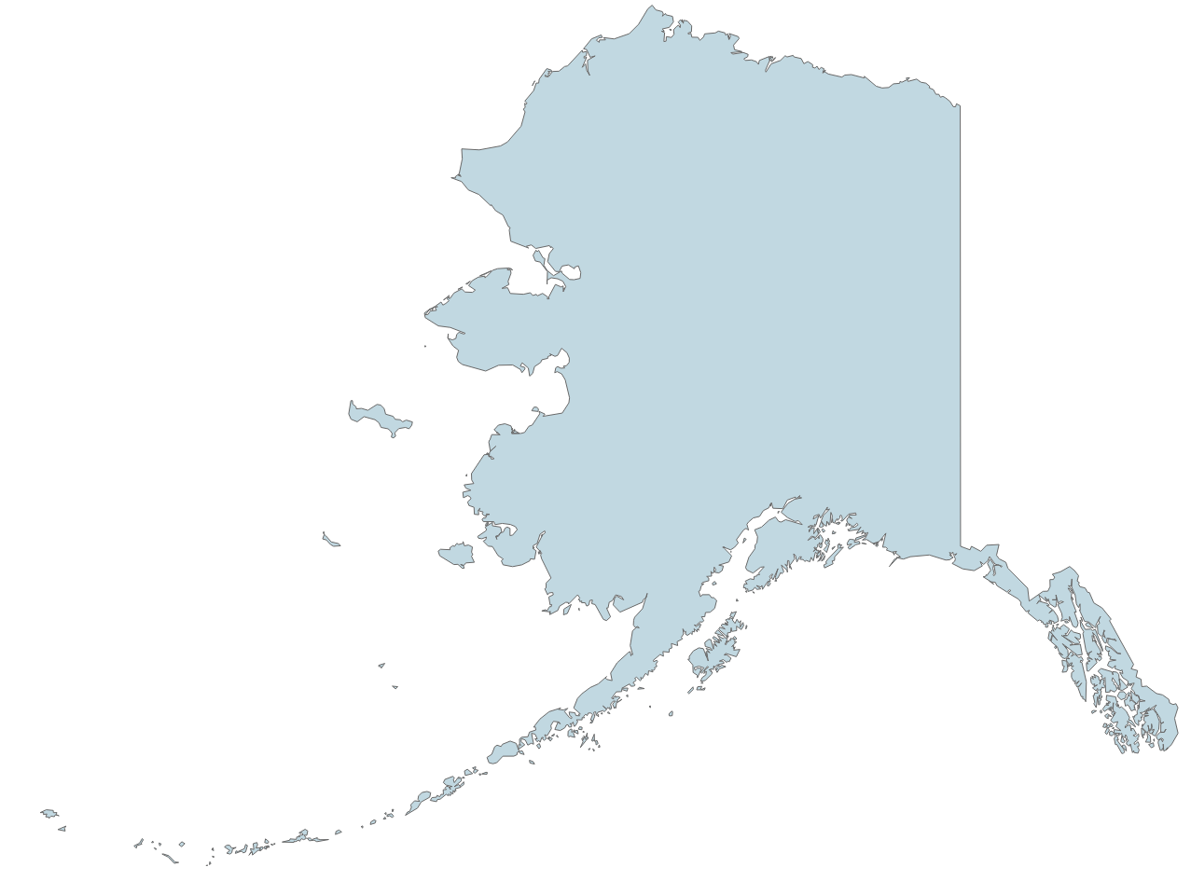

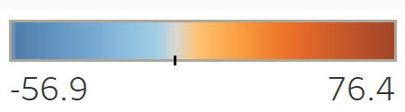
Results
Death Rate Change, per million population, US
Only two cities in our data set (for comparison)
Excepting NYC, data is normally distributed
NYC

Slide 21
Part Two Regression Modeling

Slide 22
The data, revisited
Key metrics that might explain a state’s resilience or vulnerability to a health crisis, or that have been heard explained as such, were gathered from government or journalistic sources cited at the end of this slideshow. Initial features:
Median Household Income
Median Age
Population Density
Latitude/Longitude
% Population Un-Insured, under 65
Political Party of Governor
Proportion of time under stay-at-home order
* NYC and DC are excluded from part two of this analysis for dissimilarity of information

Slide 23
Data problems, part two
In part one, the decision was made to exclude the data after 4/18/2020 as incomplete…

Slide 24
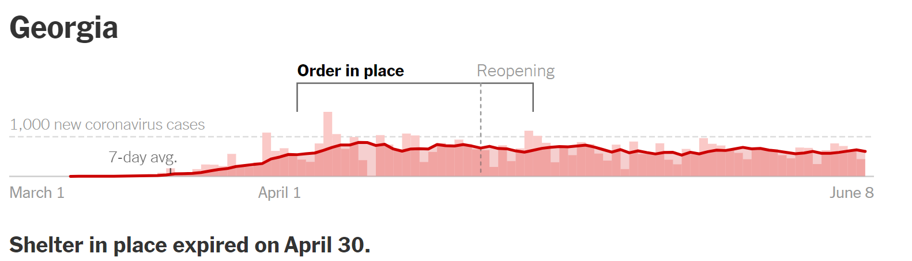
Data problems, part two
Credit New York Times
However, this means that our data does not include anything from the period after certain states re-opened. This difference in local policy will not be captured in our data.

Slide 25
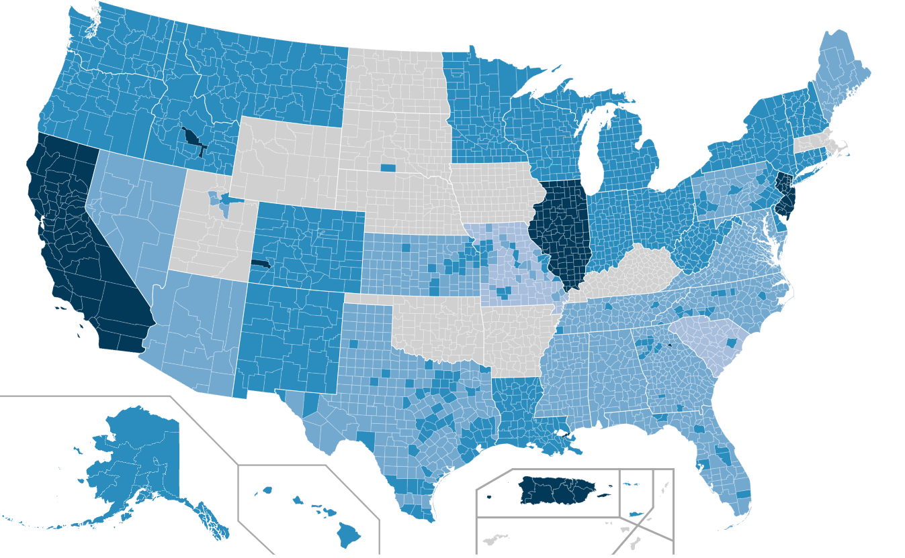
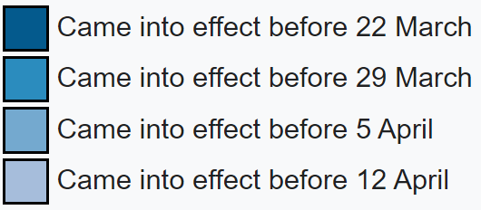
Lockdowns
US Stay-At-Home Orders by County
Due to the absence of any information regarding end-points of lockdowns, this feature was changed to an ordinal encoding of this information regarding stay-at-home order start-time.
Future versions of this model should use the originally proposed ‘percent time under lockdown’ metric, as the data permits.
Credit to Minh Nguyen for production

Slide 26
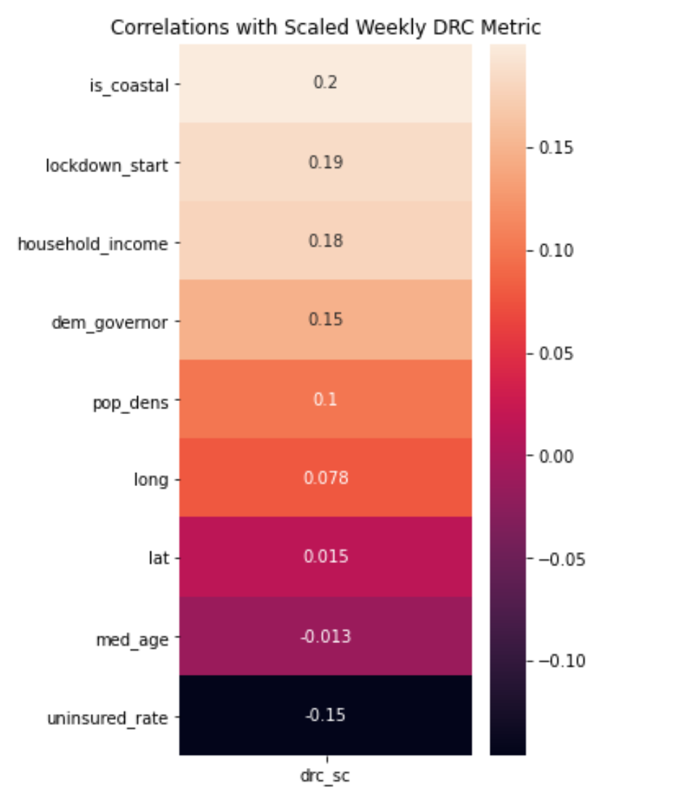
Underwhelming Correlations
The correlation numbers here were so low that a very simple, binary, ‘is_coastal’ feature was added…

Slide 27
Underwhelming Correlations
… and immediately became our top feature.

Slide 28
And Surprising
Uninsured rate and median age negatively correlated with mortality
Household income and early lockdowns positively correlated with a higher death rate

Slide 29
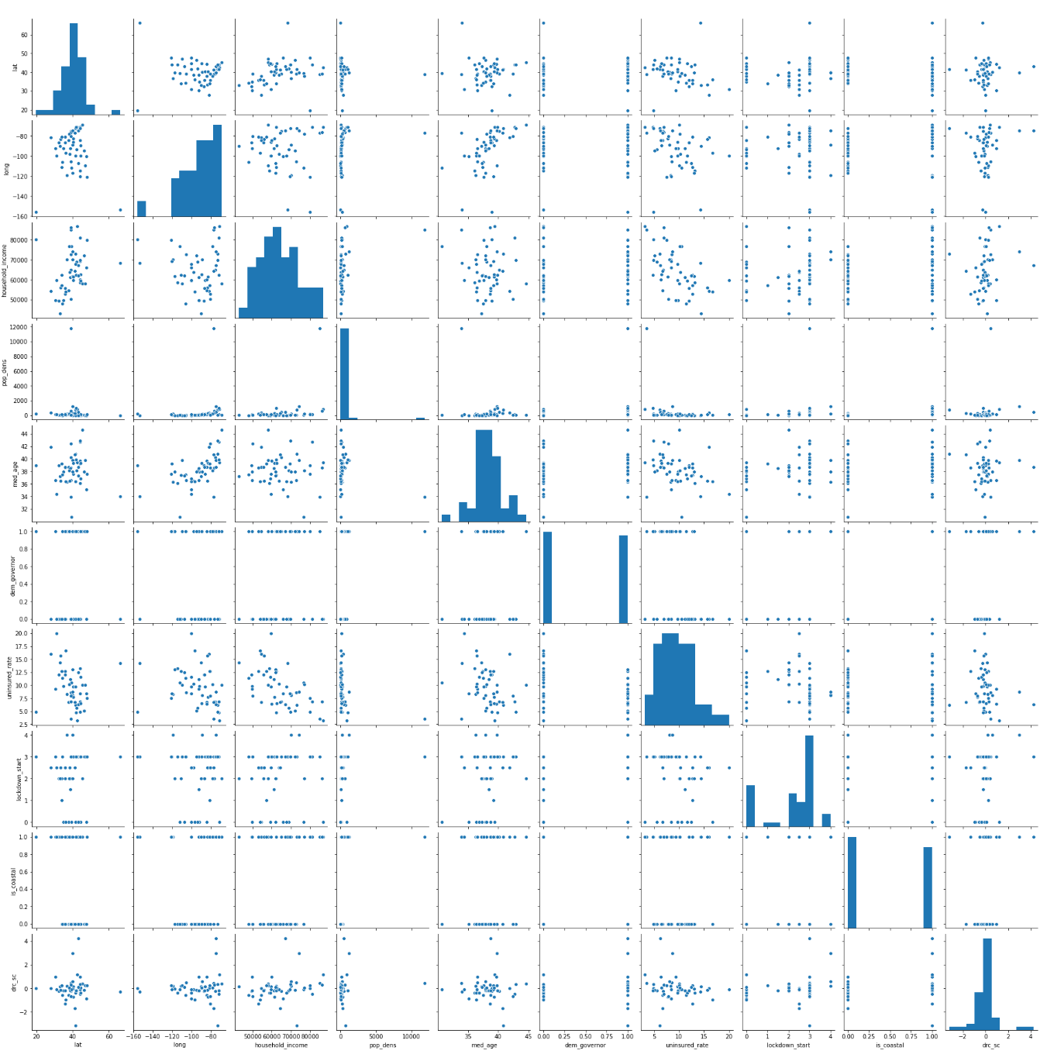
Not much to go on…
This pairplot presented just to show the lack of linear relationships in our data
Our parameter of interest is the bottom row and right column
There is a stronger correlation between latitude and household income (circled in green) than anything to our scaled DRC metric
There is a stronger correlation between latitude and longitude (red), and that is basically just an abstract picture of the United States

Slide 30
Confirmation
For the sake of completeness, a battery of simple models were run on the data, including:
Linear regression
Support vector regression
Decision tree
Bagged decision tree
Random forest
K Nearest Neighbors regression
ADA boosting
None consistently outperformed baseline

Slide 31
Conclusions

Slide 32
Caveats
The concept of this project was always to get as large-scale a picture of what is happening as possible. The available data is not comprehensive or reliable enough yet to support this approach.
At the end of the year, or even a couple years from now, after ripple effects have had time to play out, this will be a more representative picture of results.
City and country comparisons remain very appealing levels of analysis for this approach.
Another possibility would be to do the same from the other direction, trying to find inflection points in a localities economic prosperity.
There are more factors affecting mortality rates than just Covid-19.
There are more objectives to policy and societies than just reducing mortality rates.
The time-series model could just be over-estimating (a normal year’s) death rates, hence the seemingly normal distribution in DRC (the relative comparison between states should still be relevant, even in this case).

Slide 33
Conclusions
No considered feature, or combination thereof, was a strong predictor of having a higher mortality rate in 2020 than would be expected, covid-related or not.
While it has dominated the consciousness and attention of America as a whole, the lethal consequences is largely only a true crisis in certain localities as of the time represented in this data set.
This does not imply causation anywhere. It is still unclear whether lockdowns are good or bad, places are safe or unsafe from future infection, etc. At least as far as this analysis goes.
While the data is not settled enough yet, the fundamental idea in this approach seems to have promise
Using a time-series model, rather than a rolling average, is a better baseline for any excess death analysis if there is the possibility of trend in the data.

Slide 34
Thank You

Slide 35
Citations
https://github.com/TheEconomist/covid-19-excess-deaths-tracker
https://www.nytimes.com/interactive/2020/us/states-reopen-map-coronavirus.html
https://www.latlong.net/category/states-236-14.html
https://state.1keydata.com/
https://dqydj.com/
https://worldpopulationreview.com/states/state-densities/
https://en.wikipedia.org/wiki/COVID-19_pandemic_lockdowns#United_States
https://www.census.gov/
https://www.dol.gov/ui/data.pdf

